Slide 1


CMR TECHNICAL CAMPUS
UGC(Autonomous)
Accredited by NBA & NAAC with ‘A’ Grade
Approved by AICTE , New Delhi & JNTU, Hyderabad
Department of Computer Science Engineering
A Mini Project on
WATER QUALITY MONITORING AND FORECASTING SYSTEM
Presented by:
P. Indhu 217R1A0544
K. Mahipal 217R1A0528
E. Mahesh Kumar 217R1A0520
Under the Guidance of
Ms Tabeen Fatima
(Assistant Professor)

Slide 2
TABLE OF CONTENTS
Introduction
Abstract
Existing System
Disadvantages
Proposed System
Advantages
System Requirements
Novelty of this project
System Architecture
UML Diagrams
Algorithms
Output Screenshots
Result Analysis
Conclusion
Future Scope

Slide 3
INTRODUCTION
Water is one of the most valuable natural resources that humans have gifted. one of humanity's most serious and concerning challenges is the diminishing condition of natural water resources such as lakes, streams, and estuaries.
These resources are also at risk of contamination as a result of a variety of reasons, including human, industrial, and commercial activity.
Drinking water contamination is exacerbated by poor sanitation infrastructure and a lack of knowledge Unclean water has far-reaching consequences that affect every part of existence.
Water resource management is critical.
Water contamination can be effectively addressed if data is examined and water quality can be fore casted ahead of time.

Slide 4
ABSTRACT
The aim is to investigate machine learning-based techniques for water quality forecasting by predicting results with the best accuracy.
The analysis of the data set by supervised machine learning technique(SMLT) to capture information like variable identification, uni-variate analysis, bi-variate and multivariate analysis, missing value treatments and analysis data validation, data cleaning/preparation, and data visualization will be done on the entire given data set.
To propose a machine learning-based method to accurately predict the Water Quality Index value by prediction results in the form of best accuracy from comparing supervised classification machine learning algorithms.

Slide 5
EXISTING SYSTEM
Sensorized equipment that can autonomously measure the important physical, chemical, and biological (PCB) characteristics is now easily available.
However, due to a lack of standardized methodologies for data collection and processing, spatio temporal volatility of critical parameters in water bodies, and novel contaminants, there is a gap between data quality, data gathering, and data interpretation.
For standardized data analysis and forecasting, sophisticated algorithms could also be used.

Slide 6

DISADVANTAGES
Less Accuracy
Low Efficiency

Slide 7
PROPOSED SYSTEM
The proposed method is to build a machine learning model for Water quality.
The process carries from data collection where the past data related to Water qualities are collected.
Machine learning is now applied and mostly used in health care where it reduces the manual effort and a better model makes error less which leads to saving the life.
Machine learning algorithms are applied to the dataset where the pattern of data is learned.

Slide 8
ADVANTAGES
High accuracy
High efficiency

Slide 9

HARDWARE & SOFTWARE REQUIREMENTS:
HARDWARE REQUIREMENTS :
System : i5.
Ram : 4 GB.
Hard Disk : 40 GB
SOFTWARE REQUIREMENTS :
Operating system : Windows8.
Coding Language : python3.7.0

Slide 10
NOVELTY OF THIS PROJECT
The project aims to provide a comprehensive solution for understanding and predicting the quality of water bodies, encompassing both real-time monitoring and future predictions.
The system uses Machine learning algorithms to learn the pattern and gives the prediction with more accuracy.

Slide 11
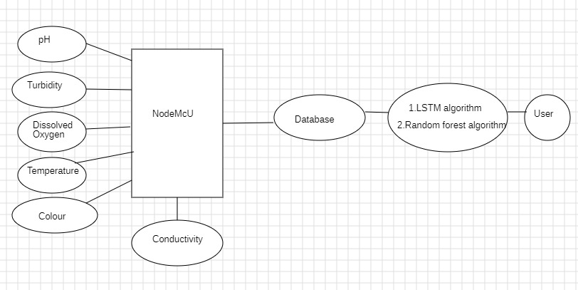
SYSTEM ARCHITECTURE

Slide 12
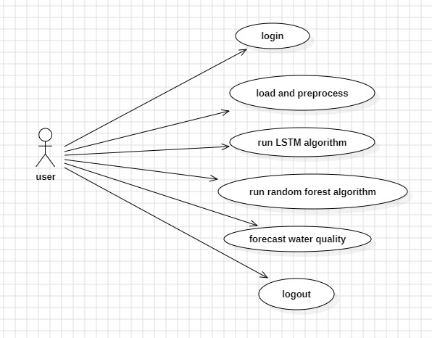
UML Diagrams
USE CASE DIAGRAM

Slide 13
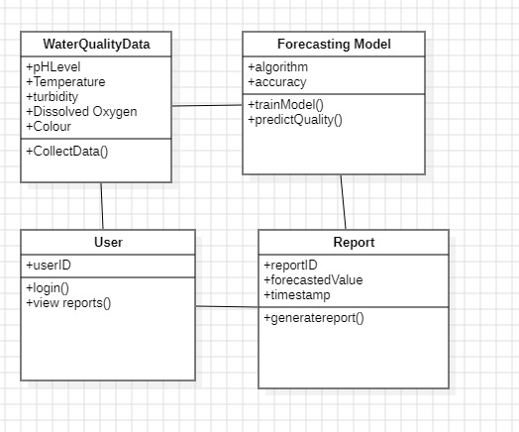
CLASS DIAGRAM

Slide 14
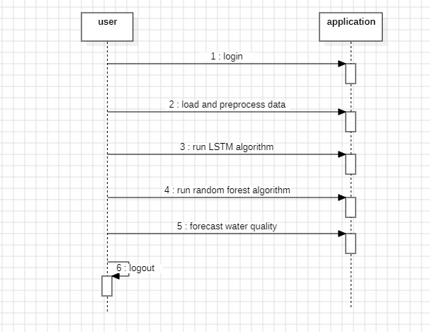
SEQUENCE DIAGRAM

Slide 15
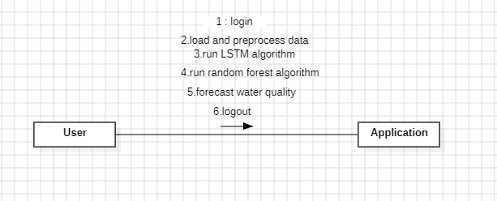
COLLABORATION DIAGRAM

Slide 16
Algorithms
LSTM(Long Short-Term Memory)
LSTM is an algorithm which is capable of learning and remembering information over time.
Random Forest Algorithm
The random forest algorithm is a machine learning technique that uses multiple decision trees to make predictions for classification.

Slide 17
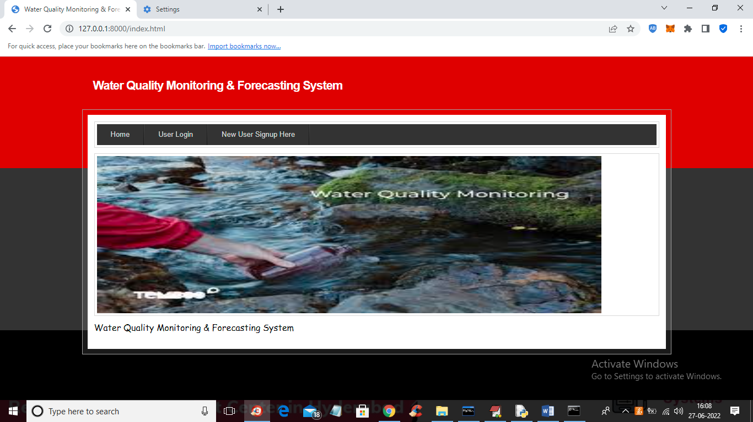
Output Screenshots
In above screen click on ‘New User Signup Here’ link to get below screen.

Slide 18
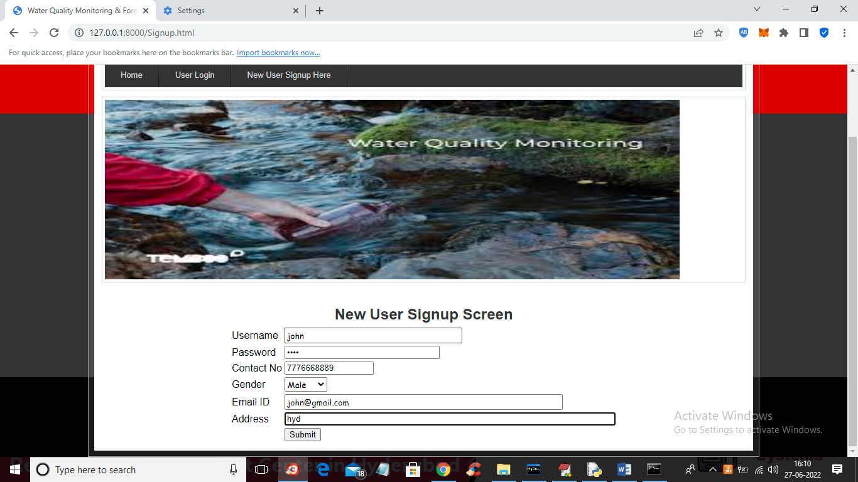
In above screen user is signing up and then press button to get below screen.

Slide 19

In above screen signup process completed and now click on ‘User Login’ link to get below screen.

Slide 20
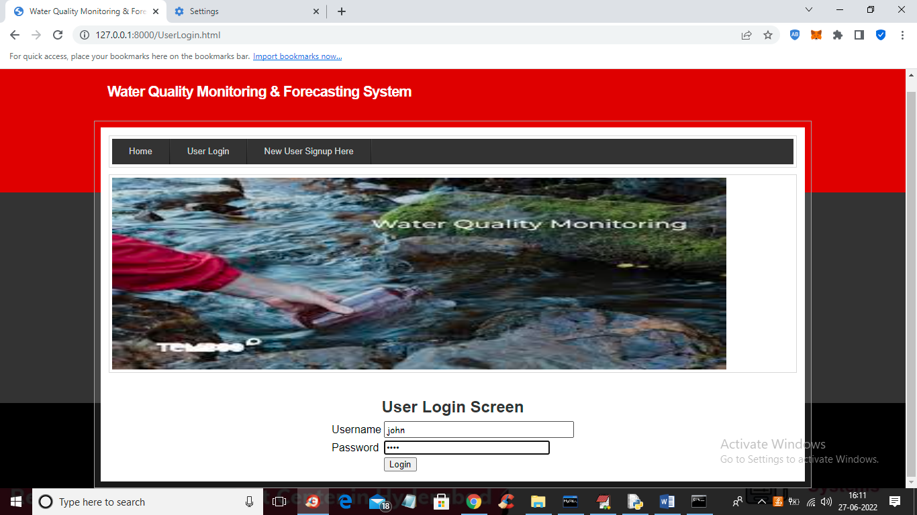
In above screen user is login and after login will get below screen.

Slide 21
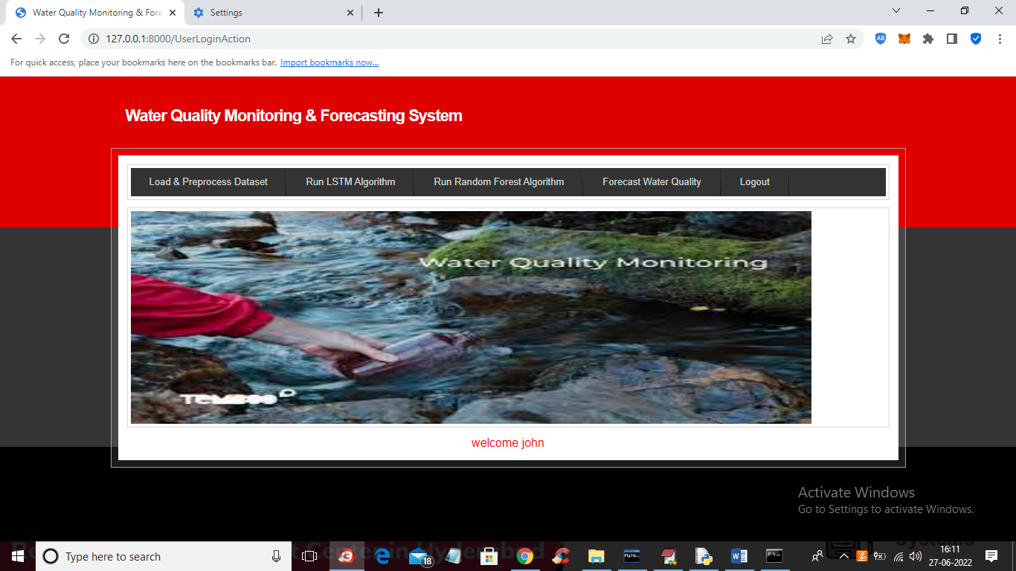
In above screen click on ‘Load & Preprocess Dataset’ link to load and process dataset such as replacing missing values with 0 and then split dataset into train and test and get below output.

Slide 22
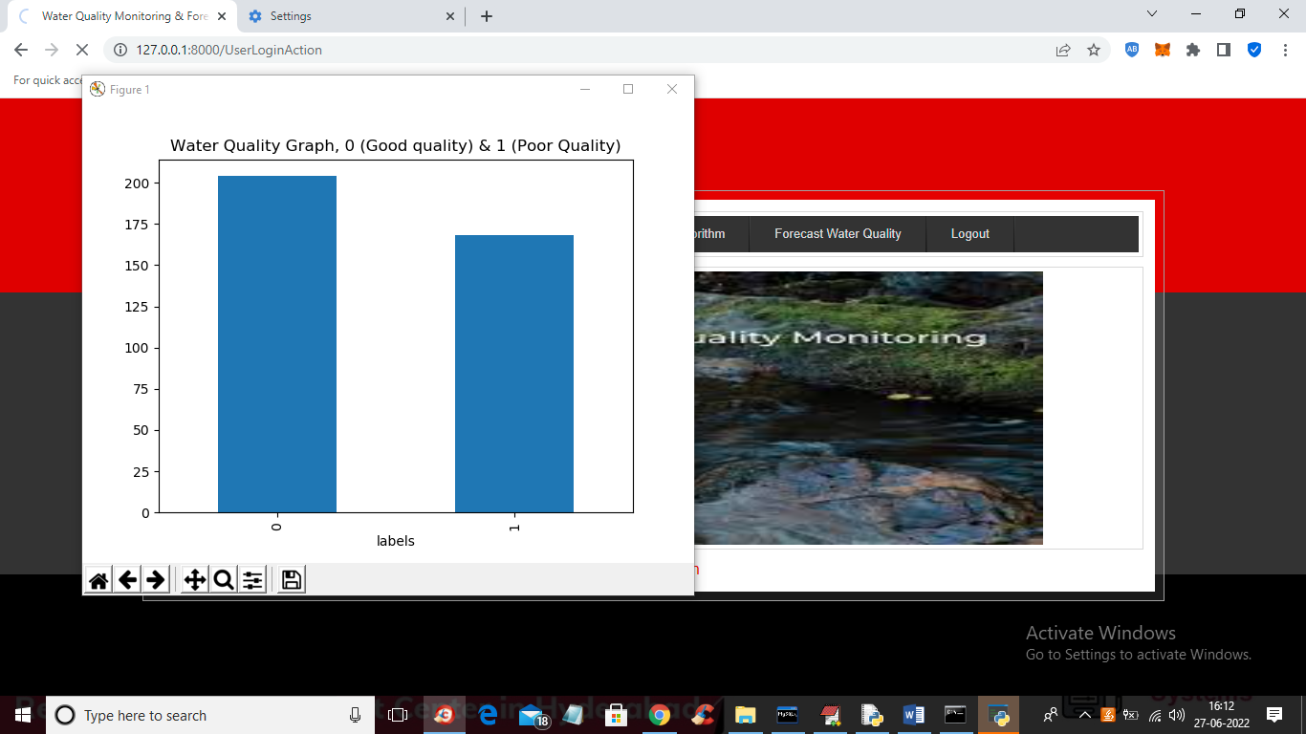
In above screen dataset is processed and in above graph x-axis contains water quality as 0 or 1 where 0 means GOOD quality and 1 means POOR quality and y-axis represents number of records and now close above graph to get below screen.

Slide 23
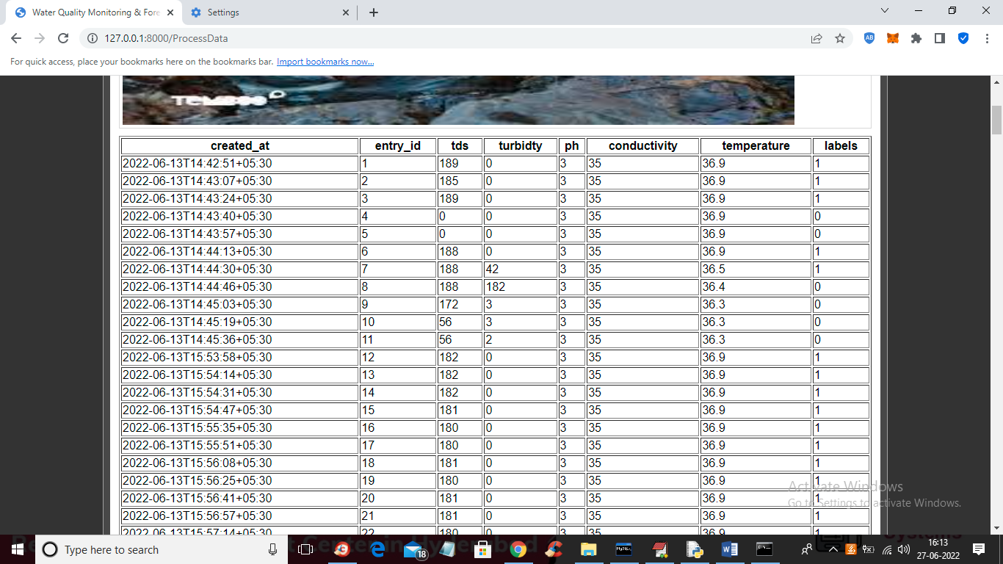
In above screen we can see dataset processed and loaded and now click on ‘Train LSTM Algorithm’ link to train LSTM and get below output.

Slide 24
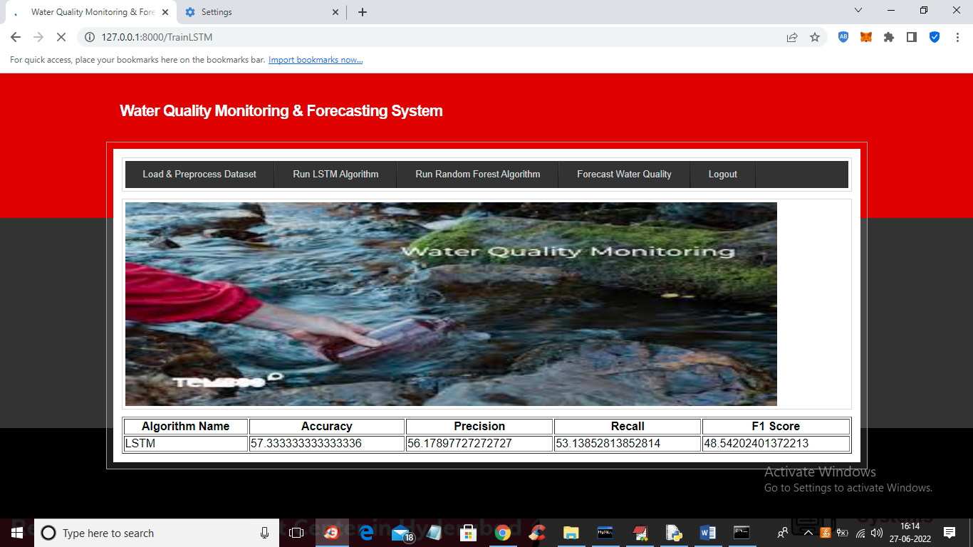
In above screen LSTM got trained and with LSTM we got 57% accuracy and now click on ‘Train Random Forest Algorithm’ link to train Random Forest and get below output.

Slide 25
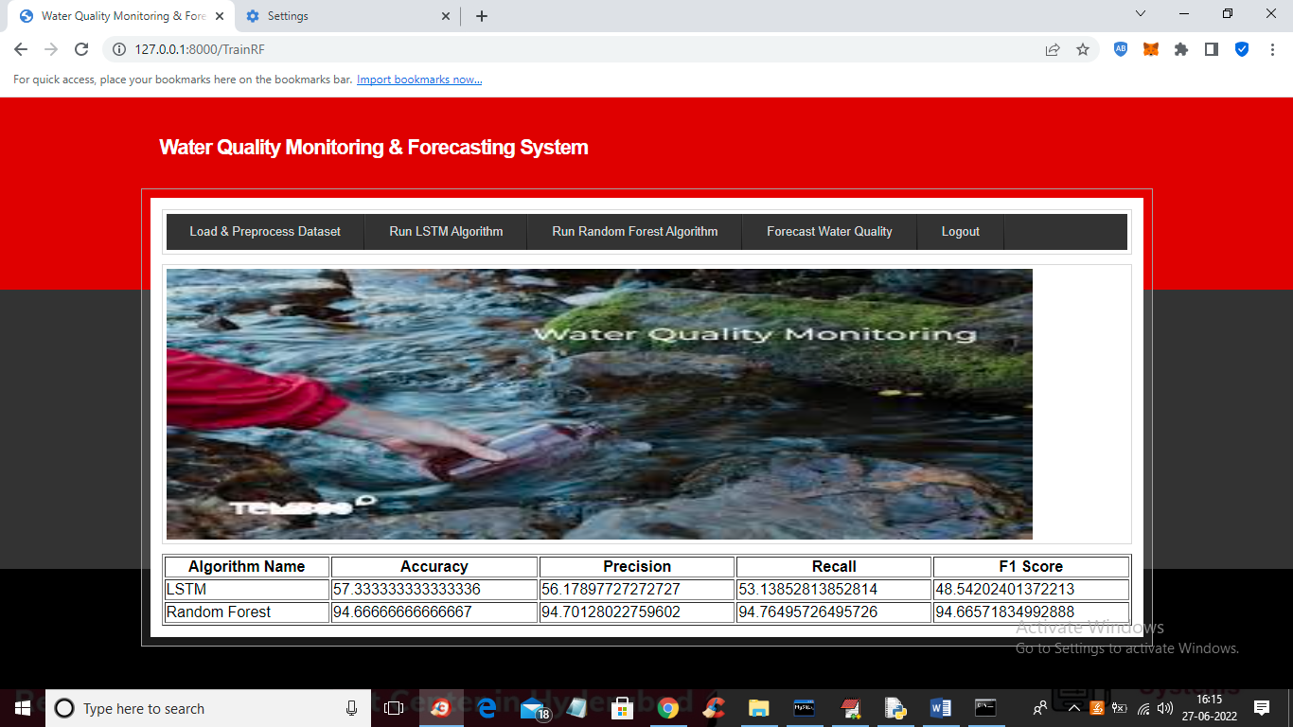
In above screen with Random Forest we got 94% accuracy and now click on ‘Forecast Water Quality’ link to upload test data and then forecast quality.

Slide 26
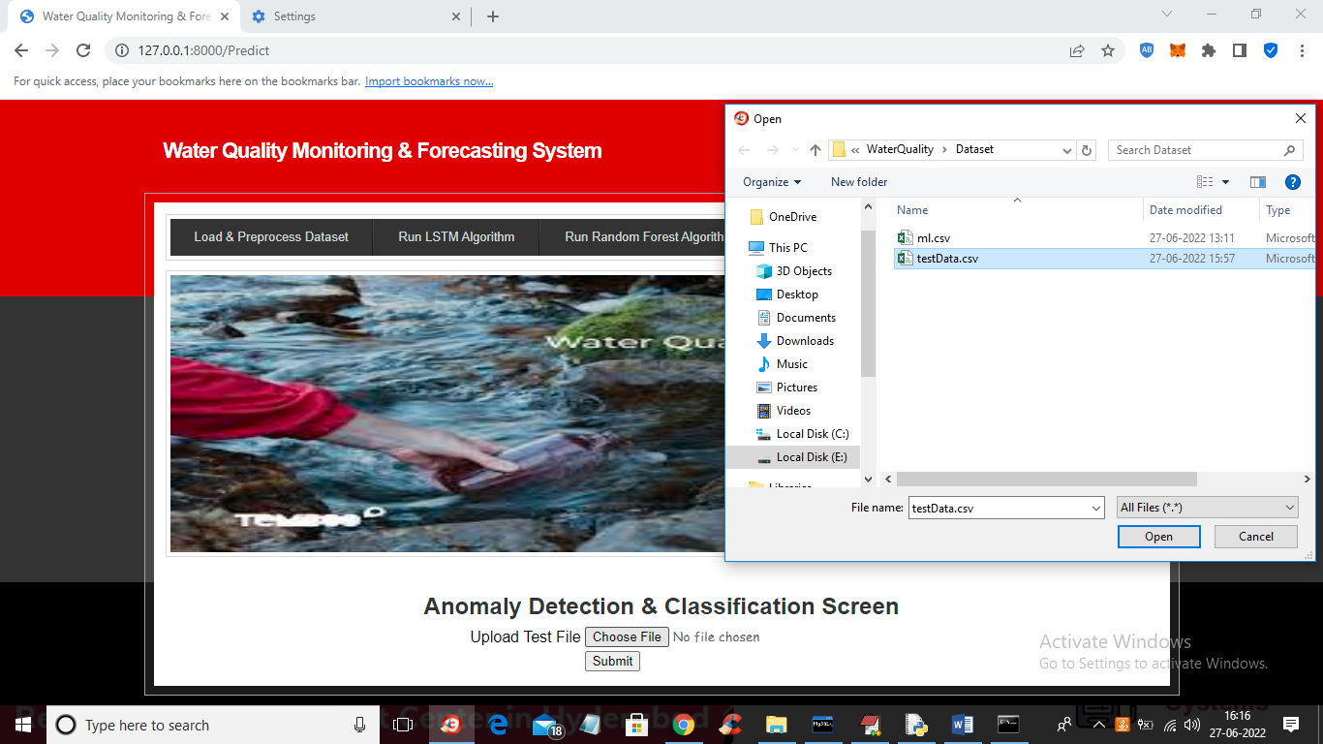
In above screen selecting and uploading ‘testData.csv’ file and then click on ‘Open’ and ‘Submit’ button to get below forecast output.

Slide 27
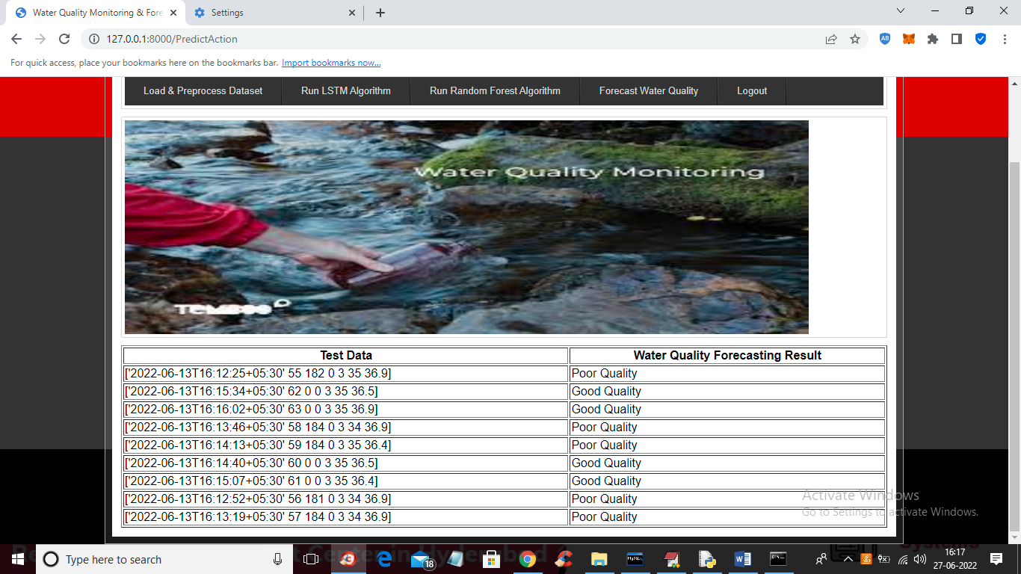
Result Analysis
In above screen in tabular output first column contains water test values and second column contains forecast result as ‘Poor’ or “Good”.

Slide 28

CONCLUSION:
Data cleaning and processing, missing value analysis, exploratory analysis, and model creation and evaluation were all part of the analytical process. The best accuracy on a public test set will be discovered, as will the highest accuracy score. This application can assist in determining the current state of water quality.

Slide 29
FUTURE SCOPE
Random Forest and LSTM for water quality monitoring and forecasting is substantial, driven by advancements in technology and heightened environmental awareness.
As computational power increases, more sophisticated hybrid models could be developed to improve predictive accuracy and handle complex data patterns.

